Slide 1
ASH NAZG
One band to rule them all
Team members: Tushar magar, Vibhav samaga and yash mutnalkar

Slide 2
The problem
We quite often see the chaos that occurs at institution gates like schools and colleges. Amidst this chaos, people slip by into college either by sneaking in, or could be with a stolen ID card. This brings about a serious question about student safety.
To tackle this problem, we came up with a solution that attempts to bring about an improvement this system which is usually quite disorganized due to human intervention for management.

Slide 3
Introduction to the solution
With this project, we look to address the disorganized ID checking system at college entrances. Our Near-Field Communication technology-empowered wristband and scanner will act as the automated system every college needs in order to up the ante on the whole entry accessibility process.
The RFID chip in each band will be scanned by an Arduino-programmed scanner, which relays the info back to a Python code, which will then analyze the validity of the info in the chip and accordingly grant entry access through the gates, thus ensuring security.

Slide 4
The Arduino code
Consists of the Write program which writes info into the RFID tag and dumps all the info into the RFID tag.
This write program uses the MFRC522.h library
The read program basically reads the info off of the RFID chip to display it on the Serial monitor
This code incorporates the use of the PySerial library to be integrated with python

Slide 5
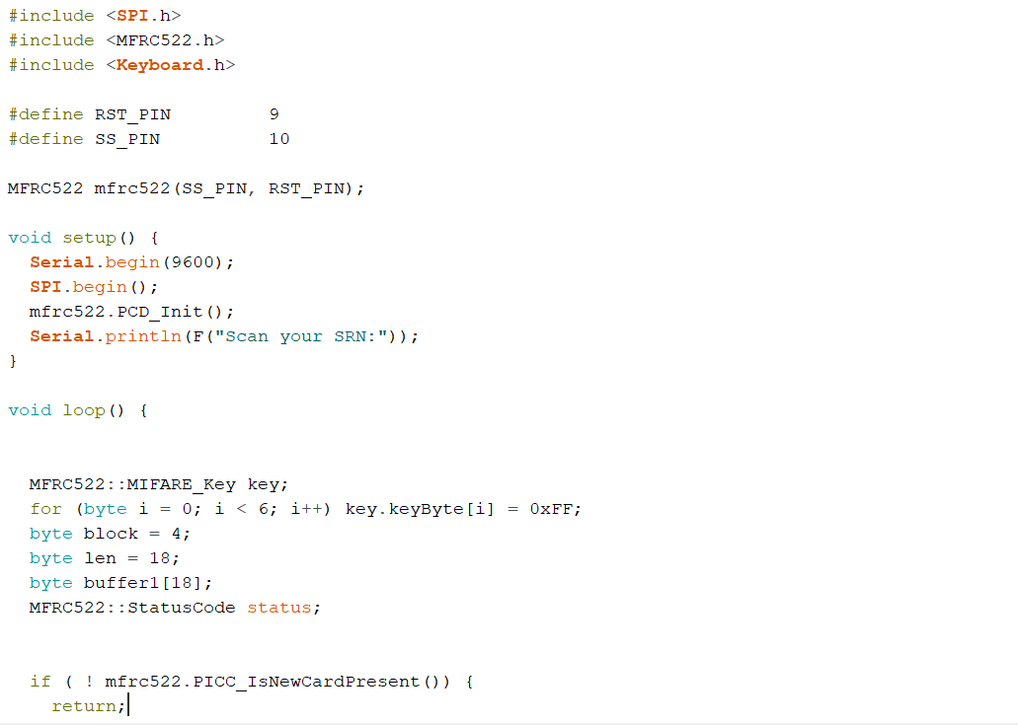

Slide 6
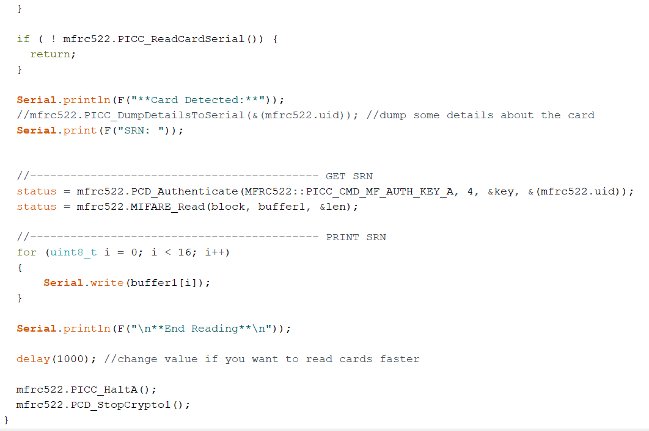

Slide 7
The Python code
How does the Python code decide the validity of the chip?
Each chip is inputted with the student's SRN. The Python code in itself consists of a list containing the SRNs of all students and upon receiving information from the Arduino, it checks if the SRN on the chip matches an SRN in the list and then accordingly displays the student information with the help of a GUI and grants him/her access to enter the gates.
The python code is able to integrate itself with the Arduino code with the help of the PySerial library. The implementation of this library for the Python-Arduino integration proved to be the most challenging part of this project for us.

Slide 8
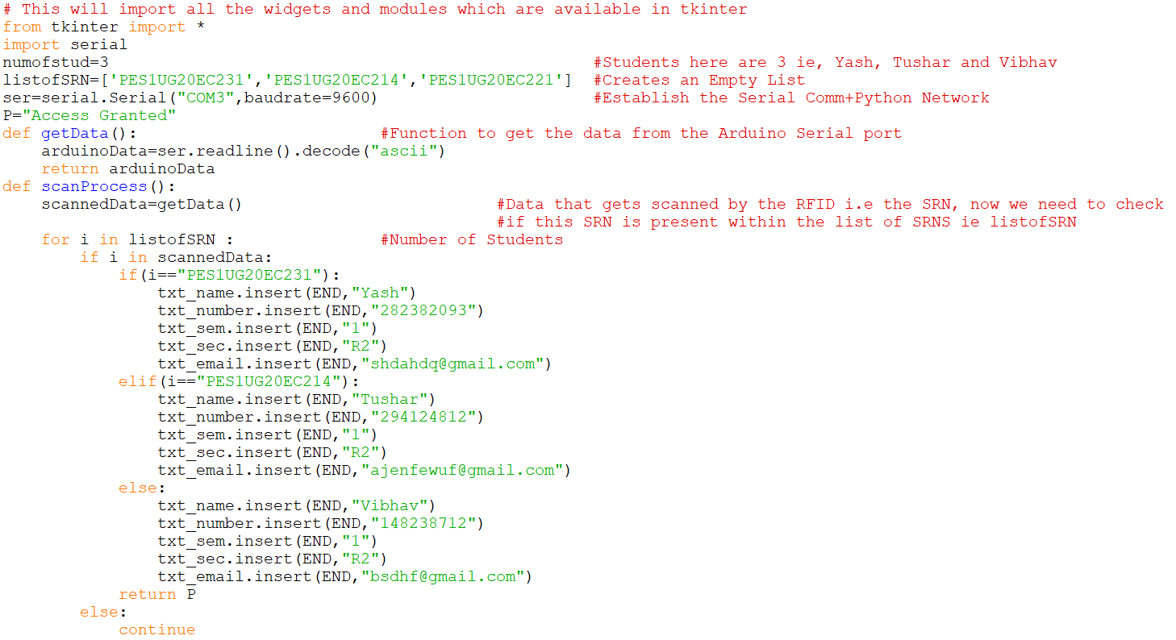

Slide 9
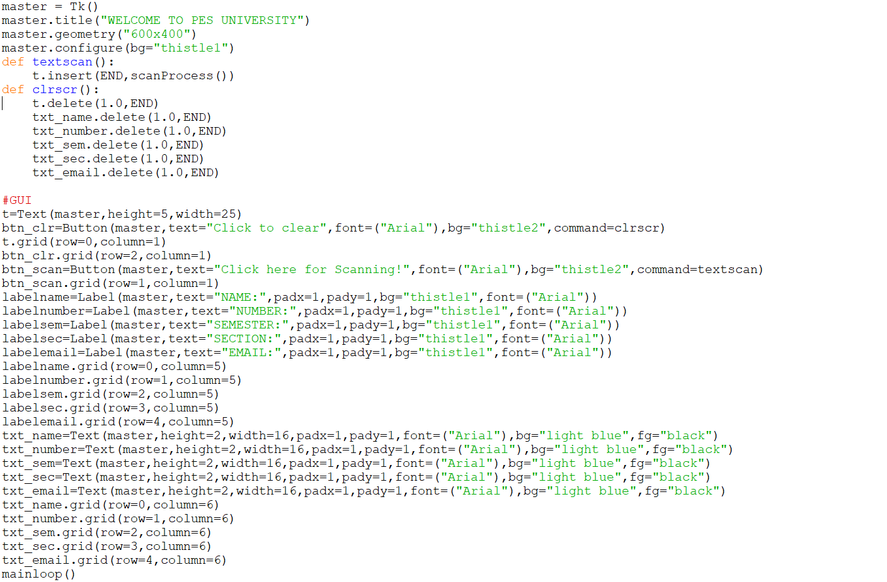

Slide 10
Future scope and our thoughts
This idea opens up many more doors to enable a unified security and record keeping system. In terms of expansion, we're looking to integrating this idea of scanners and wristbands with the process of maintaining attendance records of students by installing scanners outside classrooms.
We have also built an Arduino code to develop security for 'special-access' areas, involving the same concepts used for this project.
We believe this project is cost efficient and feasible enough to be incorporated into the current world scenario to improve the entire system of record keeping.

Slide 11
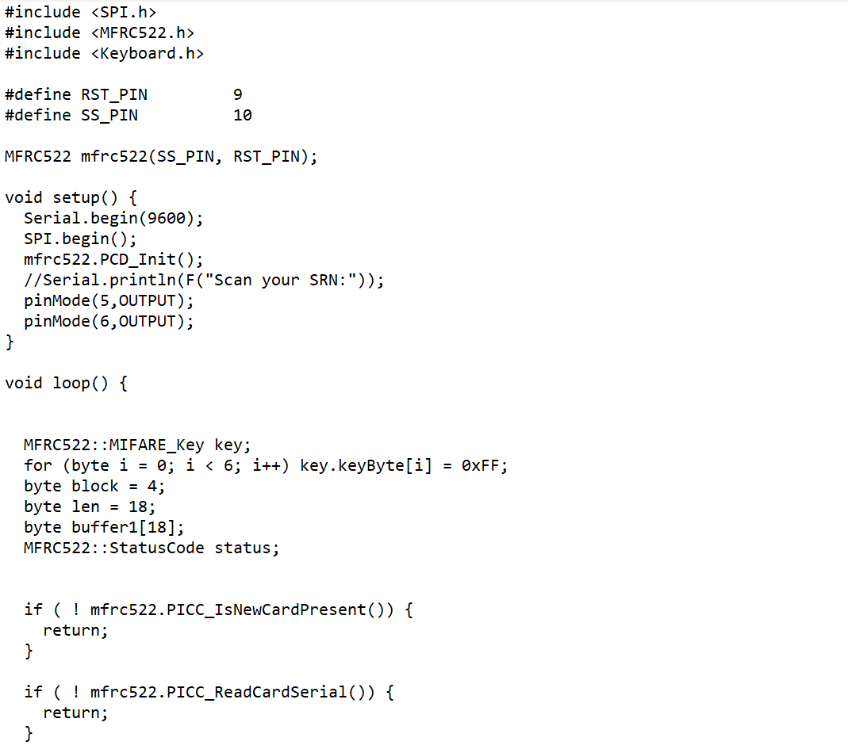
Arduino code for the security access project

Slide 12
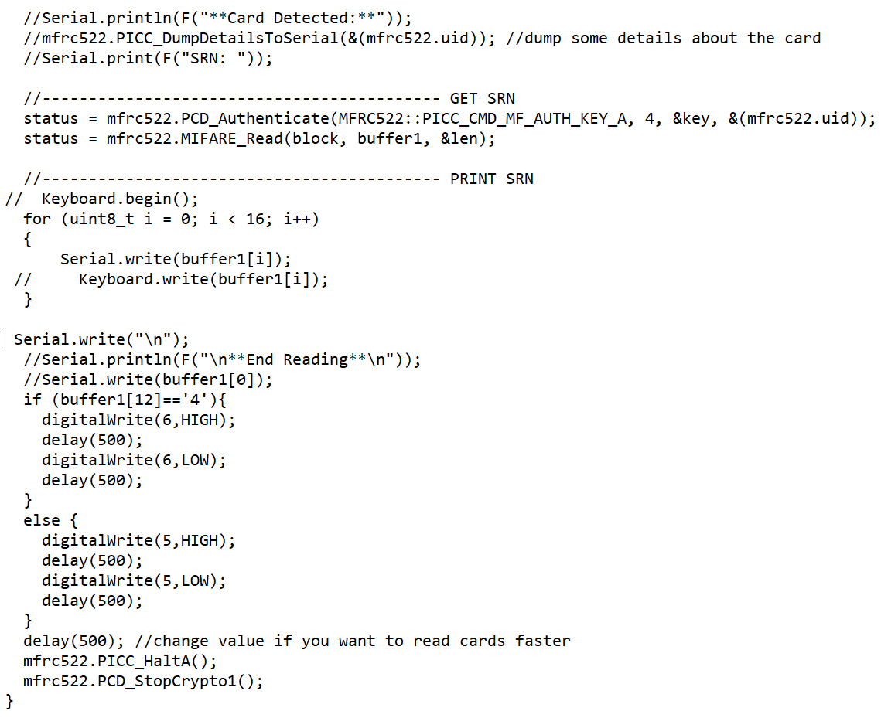

Slide 13
End
As a learning experience, this hackathon showed us a completely different side to brainstorming and problem solving that has actually motivated us quite a bit in terms of realizing ideas and executing them.

